Slide 1

Free SAP Learning Assets & Resources by end of 2025
SAP University Alliances Portfolio & Programs

Slide 2
Quick Wins
01
SAP Signavio Academic Edition
02
Learning Hub, student edition
BTP no-cost UCC/ACC offerings
03

Slide 3
SAP Signavio Academic Edition
01

Slide 4
Assets for SAP Signavio academic edition
Assets on Digital Library ➔ QSG, testimonials, starter content and materials package for universities, Sustainability and Procurement Case Study
Starter content and materials package for universities zip.file → ready and easy to use exercises and solutions, the user management guide to help set up the workspace and the Quick Start Guide for a general overview on SAP Signavio.

Slide 5




SAP Signavio Process Transformation Suite Academic Edition
The SAP Signavio Academic Edition is an offering free to students and professors to use the SAP Signavio Process Manager for modelling business processes.
Register for free and start modelling today.
Quickly create, model and simulate your processes with the free offering (six months with auto-extension possibility).
Download the starter content and materials package for universities that includes:
User management guide
Easy to use exercises and solutions
Quick Start Guide
Check out the academic starter content on SAP Signavio Learning Hub student edition for free and get inspired on how to use SAP Signavio in the classroom
Further Resources for the
SAP Signavio Academic Edition
Signavio Academic Edition Website
Quick Start Guide - SAP Signavio
Multiple SAP Signavio Learning Journeys at learning.sap.com
For more information or questions, reach out to
signavio.academics@sap.com
Notes:
Facts and Figures from 2024:
44,081 active learners
12,913 active tenants/licenses
329 educational institutions teaching Signavio AE
Six guest lectures from Signavio consultants

Slide 6
SAP Signavio, Academic Edition
Digital Library
Folder: SAP Signavio, AE Package
External links

Slide 7
Learning Hub, student edition
02

Slide 8
Assets for SAP Learning Hub, student edition
Presentation Slides ➔ For deeper dives or on-screen looping content
Roll-up Banner (Print-ready) ➔ Branded vertical banner for booth display
Infographic ➔ Visual overview of SAP Learning Hub, student edition benefits and features for lecturers
Wall Posters ➔ Designed for visual impact and quick attention catcher
Academic Starter Content ➔ All the academic lessons in one place
Connect & Exchange Corner on SAP Community ➔ For exchange and best practice sharing
SAP News Center Article ➔ Use as a credibility booster or additional material to read for interested faculty
Katharina’s Social Media Post ➔ Refer to it in case faculty wants to engage on social
General FAQs ➔ Here you find frequently asked questions along with their corresponding answers
Onboarding videos ➔ Find bite-sized videos to get familiarized with the key features of the offering
Introductory video ➔ Targeted at lecturers to provide context and spark interest
How to register ➔ Guide on how to register and get started immediately
Student-directed assets ➔ Assets directed at students

Slide 9
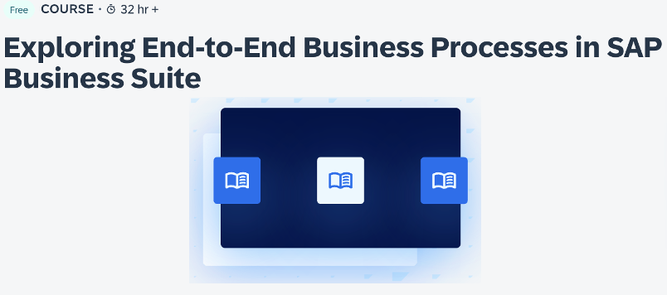
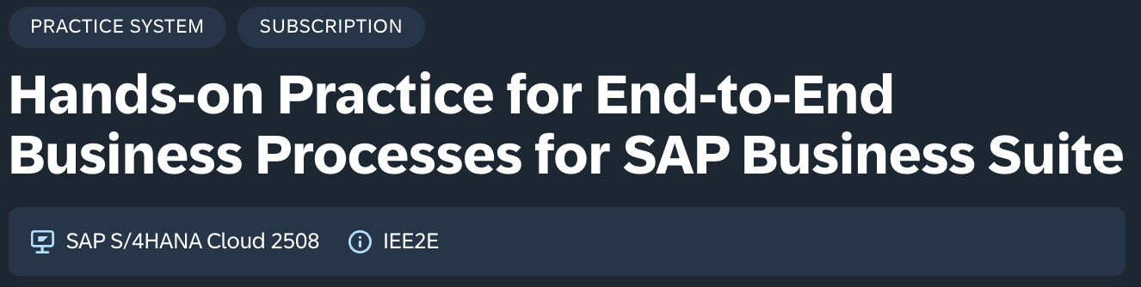
Suggested Course
End-to-End Business Process for SAP Business Suite
Links
LHSE Course
Audience:
Business / Business Information Systems lecturers teaching core business processes. Lecturers already use Global Bike, ERPsim or other ERP curriculum.
Opportunity for Q4 2025:
Complete one unit’s hands-on exercises; messaging is that you’ve seen on-prem business process, now test drive one key process in SAP S/4HANA Cloud Public Edition. Cho
Long-term opportunity:
Tackle the full course, practice system access and certification as follow-on to ERP learning happening in the classroom
Get started:
Start the learning journey (link on right), choose the one business process that fits the class / student interest, subscribe to the practice system and get familiar with the relevant exercises
LHSE Practice System
Units with Hands-On
4 - Accounting
6 - Procurement
7 – Production
8 - Sales

Slide 10
Tips & Tricks
for Using Pieces of Academic Lesson or Learning Journey
Every student needing to complete the hands-on piece must subscribe to LHSE; it takes a couple of days to verify academic affiliation and assign the subscription – immediate access is not possible
The Academic Lesson Matrix (here) has links to each lesson, outlines learning objectives, notes whether AI is featured (and how), the SAP solution, and whether a practice system is utilized
  be sure to check carefully as it is not always obvious when demos / interactive value journeys are used instead of live cloud systems
Academic Lessons include links to every learning journey and practice it references; activities with hands-on exercises are noted as well to make it easier to select pieces to showcase
  If you choose to do a subset of the exercises in a course, be sure to test in advance as there is always a risk that a future exercise only works if an earlier one is completed
Practice systems have specific start and end timeframes – it is important to be aware of when systems will (and will not) be live to ensure that your chosen learning experience is available
Every person participating must enroll in the system and take note of their assigned group number to complete the exercises; when accessing the system each person sees a pop-up with the setup guide and exercises

Slide 11
Tips & Tricks
Learning Hub Student Edition Challenge 2025
The point of the challenge is to encourage lecturers and students at events to experience the LHSE learning journeys and influence our KPI; lecturers are encouraged to use LHSE with students in 2026 but this challenge only runs through year-end
To qualify for a prize, there must be 10+ students that have activated their subscription, started a learning journey and spent time using a cloud practice system
Lecturers can choose how/where this activity is executed, it can be assigned as homework, defined as extra credit / bonus points or in collaboration with a student club as examples

Slide 12







Announcing: Learning Hub Student Edition Challenge 2025
Now to December 15, 2025
Fun learning opportunity with friendly competition
Provides SAP feedback on offering
Open to all lecturers
10+ students
Use in class, as extra credit or with a student club
Must use learning journey and its practice system
Choose any academic lesson or select relevant learning journey / course
Lecturer must provide feedback via survey
Students are encouraged to share feedback
Survey link will be added
Swag for students
Recognition as front runner for you and your university
Drawing for coaching session
Bonus for certification
Classes with most certified students featured in future storytelling / marcomm

Slide 13
BTP no-cost UCC/ACC offerings
04

Slide 14


Quick Wins with SAP Build Sandboxes from UCC/ACCs (UA full members only)
No cost offering – University may book the system now, use it in spring/fall semester 2026
Process Robotizaion with SAP Build Process Automation
01
Academic institutions have the great opportunity to sign up university for free SAP Build Sandbox for one of the available topics: Process Robotizaion with SAP Build Process Automation, Low/No-Code development with SAP Build Apps, Vibe-coding with SAP Build Code (available CW47).
02
The offer can be requested with no additional contract directly from UCC Magdeburg (using btp@ucc.ovgu.de ) who provides the access to Build Sandboxes to full member UA institutions globally.
Low/No-Code development with SAP Build Apps
03
When requested - access start date may be nominated by a university, but the Sandbox has to be reserved from UCC Magdeburg before December 12, to be counted into KPI “Universities teaching cloud”

Slide 15


SAP BTP Pro-Code Curriculum (UCC Munich):
Free of charge access could be ordered for 1 full year, if booked before Dec. 31 2025.
Level | Computer Science and Information Systems students with basic knowledge in ABAP and SAPUI5 programming (For acquiring basic knowledge, see S/4HANA Application Development Curriculum)
Duration | 8 hours
Language | English
Pro-Code Application Development with SAP BTP ABAP Environment and Business Application Studio
  The SAP Business Technology Platform (BTP) is a cloud platform that provides services for the next generation of SAP application development. Building on the S/4HANA Application Development Curriculum, our BTP Pro-Code Curriculum teaches Restful Application Programming and Cloud Application Programming on the BTP. The exercises use ABAP Cloud Projects in Eclipse and Business Application Studio in the cloud to create and manage applications. A Cloud Connector enables integration with an on-premise system.
  Learning Environment
Introduction to Enterprise Software Engineering
Slides
Environment Setup
Exercise
RAP
RAP with Remote Data
CAP
RAP Managed
RAP Unmanaged
RAP with Remote Data*
CAP
Universities signed up for this offer are counted into KPI ”Universities Using Cloud” >> to request the offer please reach out to UCC Munich (philipp.landler@tum.de ) who provides the acess to the BTP Pro-Code Curricualum Globally
SAP Fiori / SAPUI5
Covered Technologies and Used Tools
Core Data Service (CDS)
ABAP CDS
CAP CDS
ABAP
NodeJS
Eclipse, BAS, and BTP ABAP Environment
BAS and Cloud Foundry
If registered by 12/31/2025, you will receive free use of the SAP BTP Pro-Code environment throughout 2026.
The RAP with Remote Data exercise requires the connection to an on-premise S/4HANA client. This client, with example data, is currently provided by the UCC Munich.
Fees (P2) | 600 EUR* for 6 months / 1,100 EUR* for 12 months
Provider (current) | UCC Munich
Price applies in connection with an S/4HANA development client. Without client (P3): 1,400 EUR for 6 months / 2,600 EUR for 12 months

Slide 16
UCC/ACC Cloud offerings beyond no cost
05

Slide 17
GTM Materials
Teaching Assets One Pagers – All SAP Cloud Solutions Offerings (External use)
University may book the system now, use it in spring/fall semester 2026
UCC/ACC Offers that include Sandboxes are in green
Solution | Sub-solution | Content Owner | Offering Description
SAP Build | SAP Build Process Automation | UCC Magdeburg | Published
 | SAP Build Apps | UCC Magdeburg | Published
 | SAP Build Code | UCC Magdeburg | Coming soon!
SAP Datasphere |  | UCC Magdeburg | Published
SAP Integration Business Platform (IBP) |  | UCC Magdeburg | Published
SAP Sustainability Solution |  | UCC Magdeburg | Published
SAP Analytics Cloud | GBI using SAC | UCC Magdeburg | Published
 | SAC | UCC Milwaukee | Published
SAP Ariba |  | UCC Chico | Published
SAP SuccessFactors |  | ACC Melbourne | Published
SAP Signavio | Process Mining | UCC Munich | Published
SAP BTP | SAP BTP Pro Code (ABAP) | UCC Munich | Published
 | SAP Integration Suite | ACC Sierre | Published
Low-Cost Offers (UCC/ACC partners)
Free Offering
Solution | Content Owner | Offering Description
Business Builders | SAP UA | Published
SAP Signavio Transformation Suite, AE | SAP UA | Published
SAP Learning Hub, student edition (+ Academic Lessons) | SIX & UA | See in deck in dedicated section

Slide 18
Appendix

Slide 19















GTM Materials
Digital Library: Package Assets (External Use)
SAP S/4HANA
SAP Analytics Cloud
SAP Integrated Business Planning
SAP Sustainability
Learning Pathways
SAP BTP
SAP Signavio
SAP SuccessFactors
SAP Business AI
Business Builders
SAP Build
New
ERPsim
SAP Datasphere
SAP LeanIX
SAP Academic Lessons with LHSE

Slide 20



GTM Materials
Digital Library: Package Assets (External Use)
SAP and Quantum Computing
SAP Business Data Cloud
SAP Business Suite
New
New

